Slide 1
A Novel Adoption of Long Short Term Memory (LSTM) in Touchpoint Prediction Problems
K.C. Tung, PhD
Principal Data Scientist
AT&T Advertising & Analytics
Thursday, September 6, 2018

Slide 2
Resources and special thanks to:
machinelearningmastery.com
github.com/tensorflow/nmt
github.com/sachinruk/deepschool.io
research.google.com/colaboratory
colah.github.io/posts/2015-08-Understanding-LSTMs
Coursera
Jason Brownlee – Great author. Learn RNN in Keras
Thanh Luong and Google folks. Great model and explanation for seq2seq LSTM
Learn seq2seq using Tensorflow
Free Jupyter Notebook environment with latest Tensorflow and Keras.
Christopher Colah’s famous LSTM blog
Andrew Ng
Question, feedback, request: kctung75034@gmail.com
Github handle: shinchan75034

Slide 3
My GitHub Gist Jupyter notebooks
https://tinyurl.com/y8bmqoa6 (Keras)
https://tinyurl.com/y8rduwys (Tensorflow)
https://gist.github.com/shinchan75034 (Gist)

Slide 4
Three - parts talk
How the customer journey problem is formulated historically.
As a campaign planner, I would like to improve ROI of my campaign by identifying users’ potential for conversion. I would like to place this in a bigger context of their exposure as a journey, so I can better plan my campaign spending.
Formulate customer journey problem in a broader context of sequence prediction problems.
Business rule
Data structure
Vocab (dictionary construction)
Condition for input and requirement for output
Sequence prediction model (seq2seq).
Encoder – decoder framework
Output types as described by state and value

Slide 5
current place, next place
daypart, day of week

Slide 6
How does it knows….
How does it know it’s time for me to go to work?
How does it know where I work?
How does it know I am headed to work?

Slide 7
My Daily Routine
Home
Drive
Office
Drive
Gym
Location
Wifi to cellular
Bluetooth connects
Time
Location
Bluetooth disconnects
Cellular to Wifi
Time
Location
Wifi to cellular
Bluetooth connects
Time
Location
Bluetooth disconnects
cellular to Wifi
Time
State_A
State_B
State_C
State_D
State_E

Slide 8
Part 1 - How a customer journey problem is formulated historically

Slide 9
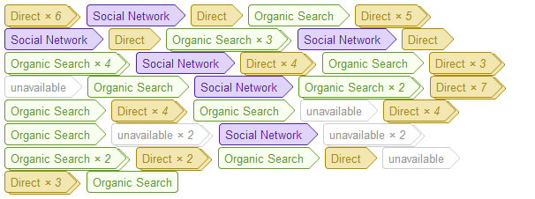
Sequence as a model for online shopping touchpoint
Web Analytics 2.0 by Avinash Kaushik
Which exposure channels are more effective than others? This is an attribution problem.
Customer online shopping experience may be modeled as a sequence problem.

Slide 10
Sequence as a model for media touchpoints
NBC
CBS
TNT
ABC
ESPN
Conversion
NBC
NBC
NBC
Conversion
TNT
CBS
ESPN
ESPN
ESPN
Conversion
Conversion
Conversion
Conversion
ESPN
Conversion
ESPN
NBC
NBC
Conversion
Label (network): channel that delivers advertising impression
Label (Conversion): measurable outcome such as a store visit

Slide 11
Attribution Models
Touchpoint sequence is used to solve attribution problem for online e-commerce.
Sites’ position in customer journey is weighted.
Credit is spread to different sites based on their final scores.

Slide 12
Examples of Attribution Model
In the Position Based attribution model, 40% credit is assigned to each the first and last interaction, and the remaining 20% credit is distributed evenly to the middle interactions.
Buy
In the Time Decay attribution model, the touchpoint closest in time to the response or conversion get most of the credit.
Buy
-5
-4
-3
-2
-1
0
https://support.google.com/analytics/answer/1662518?hl=en

Slide 13
Attribution Logics
Social network Ad
TV ad
Search
Buy
User | Epoch timestamp
user100 | 100000
user101 | 100101
user100 | 100101
user101 | 101100
user101 | 102450
user102 | 100099
user103 | 100123
user103 | 100150
user104 | 100000
user105 | 100101
User | Epoch timestamp
user100 | 99801
user200 | 102100
user101 | 101450
user102 | 100200
user202 | 103110
user103 | 99931
user103 | 97164
user104 | 101002
user104 | 101300
user104 | 101500
user105 | 98756
User | Epoch timestamp
user100 | 99000
user101 | 98000
user101 | 101234
user101 | 102440
user102 | 100100
user104 | 100101
user201 | 102123
user202 | 103103
user105 | 100200
user100 | 100200
user100 | 101002
User | Epoch timestamp
user100 | 99800
user100 | 100240
user101 | 100203
user101 | 100407
user101 | 100241
user102 | 102300
user103 | 102300
user103 | 100560
user103 | 100156
user104 | 102440
user104 | 100100
user105 | 130130
user105 | 120132
user105 | 99100
user106 | 100800
User102 Attribution Spread | Social Network | TV | Search
Position Based (i.e., 40-20-40) | 0.4 | 0.4 | 0.2

Slide 14
Attribution Credits of a linear TV ad campaign
 | Network
Model | G4 | CMT | TBS | TNT | TRU | ESPN | HGTV | Direct | Total Attribution
Position Based | 411.5 | 722.7 | 7173.9 | 4972.5 | 801.1 | 41061.3 | 8787.0 | 22425 | 86355
Time decay 14 days HL | 409.1 | 734.6 | 7471.5 | 5173.8 | 851.2 | 40416.5 | 8873.2 | 22425 | 86355
Time decay 7 days HL | 410.5 | 732.4 | 7429.2 | 5171.8 | 839.7 | 40482.5 | 8864.0 | 22425 | 86355

Slide 15
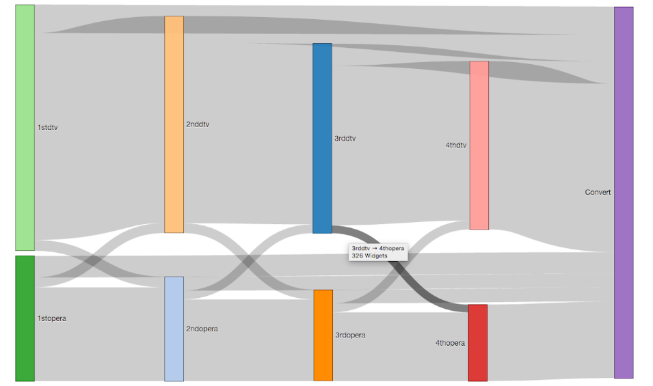
Visualizing customer journey
Use Sankey diagram to trace touchpoints.
Bar height represents sample size.
Interplay between touchpoints can be easily shown.
Not easy to interpret if no obvious pattern emerges.
More touchpoints may increase diagram complexity.

Slide 16
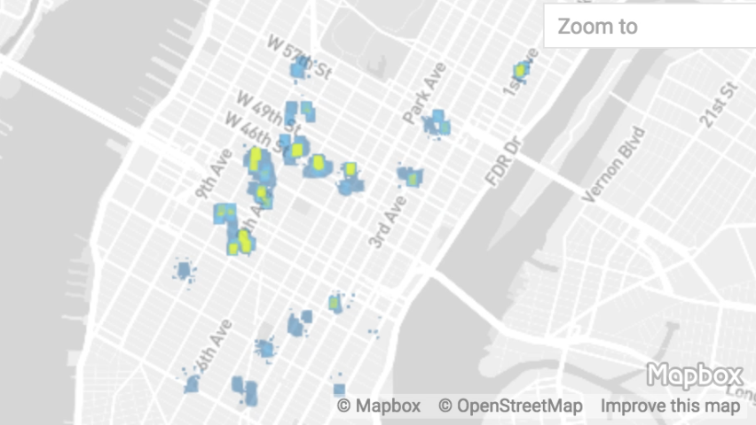
Data for linear adverting exposure
As-run log
Normalize timestamps
Customer ID | Sequence
XYZ | NBC, CBS, CBS, ABC, visit, TNT, TBS, ESPN.
PQR | Visit, ESPN
JKL | ESPN, ESPN, NBC.
Merge and order by timestamps
Set top box log
Mobile device location
Determine visit and timestamp
Place curation

Slide 17
Big picture so far
Advertising strategy may benefit from knowing favorable sequences and selection of channels.
Knowing which customer are likely to convert may help optimizing strategy.
Touchpoint sequence problems are complex modeling problems.(data collection, data science, behavioral science)

Slide 18
Part 2 - Formulate customer journey problem in a broader context of sequence prediction problems

Slide 19
Recurrent Neural Network

Slide 20
Formulating sequence models
Long Short-Term Memory Networks with Python – by Jason Brownlee
machinelearningmastery.com/lstms-with-python/

Slide 21
Recurrent Neural Network (RNN)
Long sequence is hard to learn or rationalize/
Vanishing gradient problem (very hard to deal with).
Exploding gradient problem (easy – gradient clipping).
colah.github.io/posts/2015-08-Understanding-LSTMs/
Notes:
Christopher Olah’s famous blog

Slide 22
Encoder – Decoder Architecture
d
e
f
Encoder LSTM learns input sequence and translate it to a state and value.
Decoder LSTM learns state and value provided by encoder and produce target sequence.
a
b
c

Slide 23
Data Structure
User ID | Timestamp | Touchpoint
XYZ | 20180605:18:30:44 | NBC
XYZ | 20180607:09:15:21 | TNT
XYZ | 20180609:20:35:09 | ESPN
XYZ | 20180611:09:45:55 | visit
XYZ | 20180613:17:45:44 | CBS
Order touchpoints by timestamp for each user.
Organize it as a text string.
Split text string to create input string and target string.
Predict target string given input string (hard to do it well).
Business rule: Predict target string to contain word ‘visit’ given input string (easier).
Input Sequence | Target Sequence
NBC TNT ESPN | Visit CBS

Slide 24
Use case specific requirements
Encoder input length: Longest input sequence observed at training time.
Decoder target length: Longest target sequence observed at training time.
Zero pad for short sequences if needed.
Heuristic: No worries about termination as target sequence length is predetermined.

Slide 25
User-story-driven model architecture
Observed data split
(cause + effect)
business rules
determines
determines
Data organizer
Cause pattern learner
Inference learner
Effect pattern learner
New cause inference
Knowledge formulation (model)
Effect prediction

Slide 26
Business rules
The model must handle:
Arbitrary length of observed sequence as the cause.
The observed sequence may or may not already contain the touchpoint of interest (‘visit’).
The model success criteria are:
Predict the effect as a touchpoint sequence.
The effect sequences are compared to the ground truth for presence of certain word (‘visit’).
Take advantage of business rules to simplify the model:
Fixed length source sequence by padding.
Fixed length target sequence by padding.
Only want to predict the presence of ‘visit’ in target string.

Slide 27
Data structure – User level sequences
Each item (row) represents one user’s touchpoint sequence to date, ordered by timestamps.
User’s sequence of event is observed.
For building a model, split the sequence into input and target sequences.
Train the model to predict target sequences.
Observed sequence
[‘ABC Bravo E!’,
'Discovery TLC’,
'FX TNT AnimalPlanet TBS ’,
'MTV2 ESPN’,
‘CBS NBC’,
'ESPN SpikeTV FoxSports1 CBS FOX NBC ESPN2 CW’,
'visit visit’,
'TNT NBC CBS Bravo visit’,
….]

Slide 28
Data structure – For model training purpose
Split observed sequence into two sequences
Each item (row) is a user’s touchpoint
Input sequence
['ABC’,
'Discovery’,
'FX TNT’,
'MTV2’,
'CBS’,
'ESPN SpikeTV FoxSports1 CBS', 'visit’,
'TNT NBC’,
….]
Target sequence
['<start> Bravo E! <stop>’,
'<start> TLC <stop>’,
'<start> AnimalPlanet TBS <stop>’,
'<start> ESPN <stop>’,
'<start> NBC <stop>’,
'<start> FOX NBC ESPN2 CW <stop>’,
'<start> visit <stop>’,
'<start> CBS Bravo visit <stop>’,
….]

Slide 29
Data structure – Dictionary construction
Dictionary
{'<start>': 37,
'<stop>': 40,
'A&E': 15,
'ABC': 42,
'AMC': 10,
'AnimalPlanet': 7,
'BET': 1,
'Bravo': 16,
….}
Input and target may share same vocab – depending on business rules.
In this case, 43 TV networks + ‘visit’ + <start> + <stop> = 46 tokens = vocab size

Slide 30
Part 3 - Sequence to sequence (seq2seq)

Slide 31
Encoder Decoder Structure
VISIT
ESPN
ABC
NBC
CBS
ESPN
TNT
encoder_inputs = Input(shape=(None, num_encoder_tokens))
encoder_lstm = LSTM(num_dimension, return_state=True)
encoder_outputs, state_h, state_c = encoder_lstm(encoder_inputs)
encoder_states = [state_h, state_c]
decoder_inputs = Input(shape=(None, num_decoder_tokens))
decoder_lstm = LSTM(num_nodes, return_sequences=True, return_state=True)
decoder_outputs, _, _ = decoder_lstm(decoder_inputs,
initial_state=encoder_states)
decoder_dense = Dense(num_decoder_tokens, activation='softmax')
decoder_outputs = decoder_dense(decoder_outputs)
lstm_enc = tf.contrib.rnn.LSTMCell(num_dimensions)
encoder_output, encoder_last_state = tf.nn.dynamic_rnn(lstm_enc, inputs=data_input, dtype=tf.float32)
lstm_dec = tf.contrib.rnn.LSTMCell(num_dimensions)
dec_outputs, _ = tf.nn.dynamic_rnn(lstm_dec, inputs=data_output, initial_state=encoder_last_state)
logits = tf.layers.dense(dec_outputs, units=len(char2numY), use_bias=True)

Slide 32
Sequence to Sequence Prediction (seq2seq)
Google translation service uses the neural machine translation (NMT) learning approach.
The NMT uses encoder – decoder architecture to learn a target sequence from a source sequence.
A unit of learner is a Long Short – Term Memory (LSTM) cell.
http://colah.github.io/posts/2015-08-Understanding-LSTMs/

Slide 33
LSTM Cell architecture

Slide 34
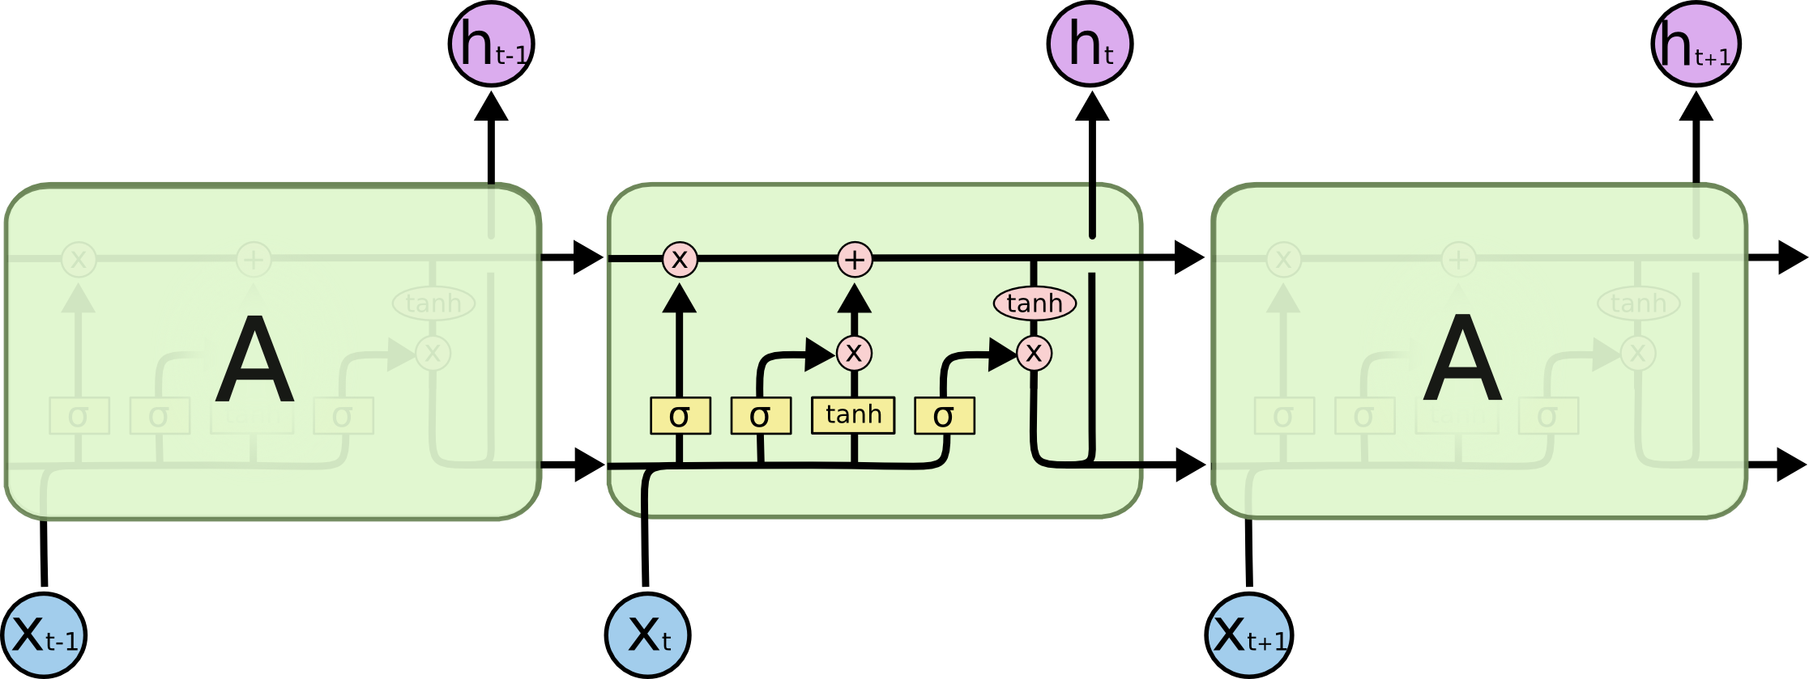
LSTM cell structure
http://colah.github.io/posts/2015-08-Understanding-LSTMs/

Slide 35
LSTM cell structure
C_{t-1}
C_{t}
H_{t-1}
H_{t}
3 σ gates + 1 internal candidate state value = 4 feed forward monolayer perceptron

Slide 36
A LSTM cell has four feed forward NN
Forget gate
Update gate
Compute internal state
Output gate
Notes:
Ht combine with Xt carries long term dependency, it figures out how much old information to keep or forget.
Ct is the short term state change.
Output is ht
Hidden cell state is Ct
For encoder we want Ct so we can tell Decoder to learn from Ct.
For decoder we want ht because our interest is in the output of decoder.
Sankey diagram indicates the need for bidirectional LSTM.
Each W is learned through iterating t. Therefore W ends up being the most ideal value of matrix that is optimized towards every transition between timepoints.

Slide 37
General Process
Tokenize events or entities.
Remove infrequent events or entities (optional).
Append special <start>, <end>, <unknown> token.
Build vocab for encoder and decoder.

Slide 38
Model performance in predicting target word ‘visit’
Holdout target sequence | Has target word | Predicted target sequence | Has target word
truTV ESPN TNT NBCSportsNetwork visit | 1 | ESPN truTV TNT visit | 1
FXX AMC ComedyCentral SpikeTV CMT | 0 | AMC Discovery FOX SpikeTV visit | 0
FOX ABC visit | 1 | NBC FOX CBS | 0
CBS USANetwork FOX | 0 | CBS FOX | 0
USANetwork | 0 | ABC | 0
ABC ESPN2 ESPN | 0 | NBC ABC | 0
ABC visit | 1 | ABC visit | 1
truTV TBS ABC | 0 | NBC ABC visit | 1
NBC | 0 | ABC | 0
NationalGeographic ESPN2 TBS | 0 | ABC NBC visit | 1
…. | …. | …. | ….

Slide 39
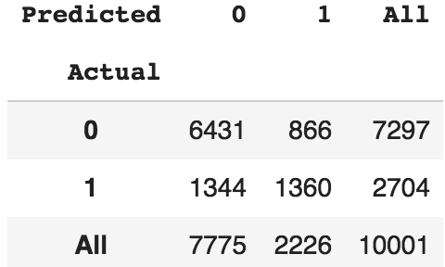
Initial model performance (Keras)
Recall = TP/(TP+FN)
Precision = TP/(TP+FP)
F1 =2*(Recall*Precision)/(Recall + Precision)

Slide 40
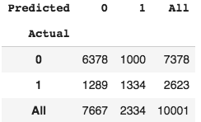
Initial model performance (Tensorflow)
Recall = TP/(TP+FN)
Precision = TP/(TP+FP)
F1 =2*(Recall*Precision)/(Recall + Precision)

Slide 41
Big picture so far
Encoder – decoder framework implemented in Keras and Tensorflow produce similar results.
Model development in encoder – decoder framework is not trivial.

Slide 42
Open Source Solution – by Thanh Luong (Google) in Github
https://github.com/tensorflow/nmt
Seq2seq python module for neural machine translation.
Bidirectional LSTM + attention.
Training, cross validation, checkpoints, holdout scoring via simple CLI.
Straightforward data and file structure.

Slide 43
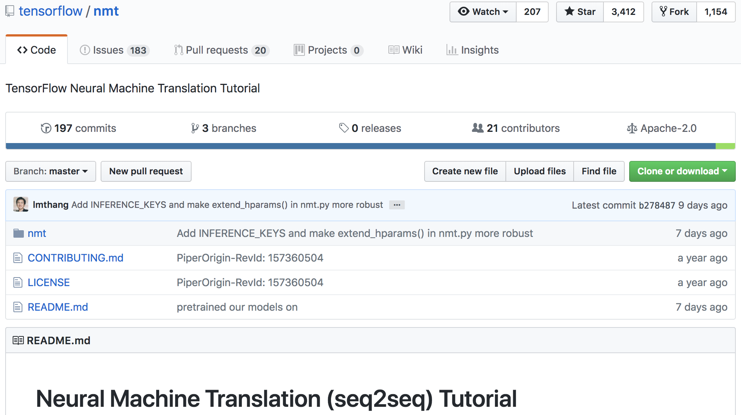
Open Source Solution by Thanh Luong (Google) in Github
https://github.com/tensorflow/nmt

Slide 44
Git

Slide 45
Train
mkdir /Users/kt6238/Documents/lstm_work/workingModel_luong_2
cd /Users/kt6238/Documents/github_clone/nmt
python -m nmt.nmt \
--attention=scaled_luong \
--src=in --tgt=tgt \
--vocab_prefix=/Users/kt6238/Documents/lstm_work/20180808_1/workingData/vocab \
--train_prefix=/Users/kt6238/Documents/lstm_work/20180808_1/workingData/nmt_train \
--dev_prefix=/Users/kt6238/Documents/lstm_work/20180808_1/workingData/nmt_dev \
--test_prefix=/Users/kt6238/Documents/lstm_work/20180808_1/workingData/nmt_test \
--out_dir=/Users/kt6238/Documents/lstm_work/workingModel_luong_4/ \
--num_train_steps=12000 \
--steps_per_stats=100 \
--num_layers=2 \
--num_units=128 \
--dropout=0.2 \
--metrics=bleu
File extension
Save model

Slide 46
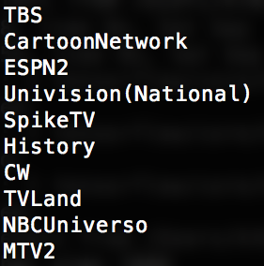
Take a look at file contents and formats
vocab
in
tgt
…
…
…

Slide 47
Inference
Scoring holdout data
mkdir /Users/kt6238/Documents/lstm_work/infer/workingModel_luong_4
python -m nmt.nmt \
--out_dir=/Users/kt6238/Documents/lstm_work/workingModel_luong_4/ \
--inference_input_file=/Users/kt6238/Documents/lstm_work/20180808_1/workingData/nmt_holdout.in \
--inference_output_file=/Users/kt6238/Documents/lstm_work/infer/workingModel_luong_4/output_infer
Model
Filename + ext

Slide 48
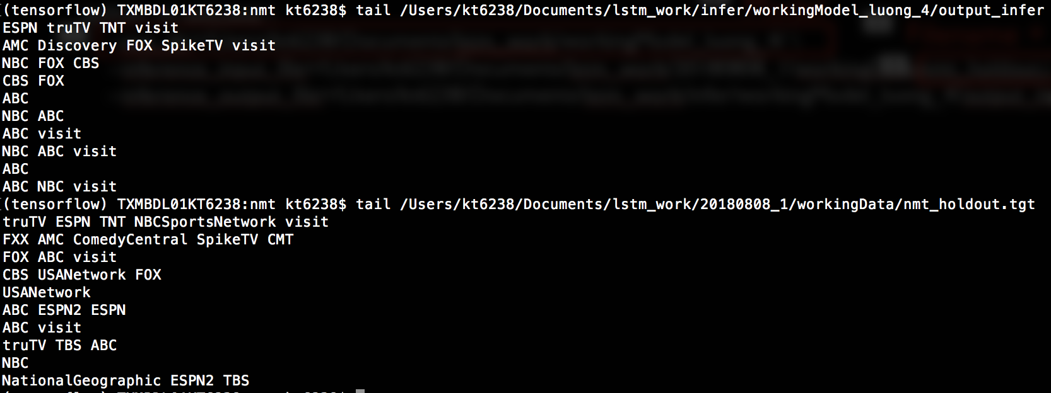
Inference holdout data
Scoring holdout data

Slide 49
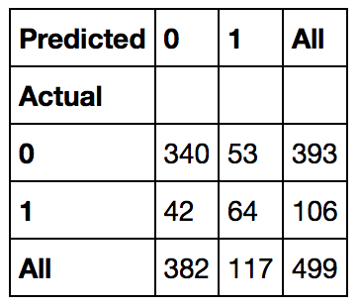
Model performance in predicting presence of ‘visit’
Recall = TP/(TP+FN)
Precision = TP/(TP+FP)
F1 =2*(Recall*Precision)/(Recall + Precision)

Slide 50
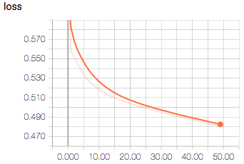
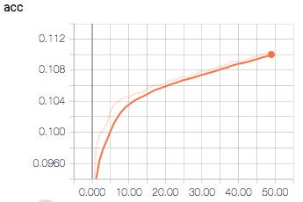
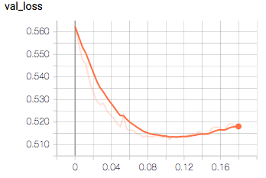
Evidence of learning

Slide 51
Model comparison
BiLSTM (Keras)
Embedding + BiLSTM (Tensorflow)
Attention + Embedding + biLSTM (Open-source solution)
Notes:
Talk more about model validation with recall and precision instead of accuracy alone.

Slide 52
Solution architecture
Ingest
process
Storage
Analyze, train, deploy
Cloud ML for model deployment
Google Colab for model creation
Cloud PubSub for raw data feed
Cloud DataFlow for ETL
Cloud Storage
BigQuery

Slide 53
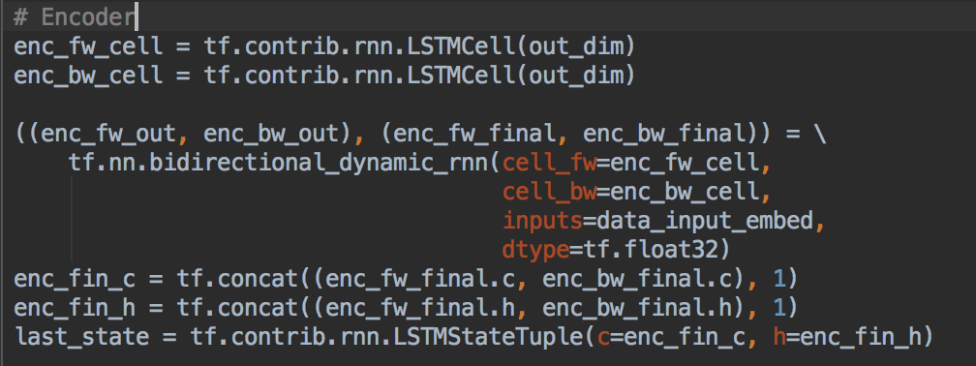
Define LSTM model in Tensorflow - Encoder
Notes:
tf.contrib.rnn.LSTMCell for seq2seq
tf.contrib.rnn.BasicRNNCell for timeseries prediction

Slide 54
Define LSTM model in Tensorflow - Decoder

Slide 55
Define LSTM model in Tensorflow – Loss function

Slide 56
Checkpoint – Tensorflow
# Add ops to save and restore all the variables.
saver = tf.train.Saver()
sess.run(tf.global_variables_initializer())
best_loss = 1
for epoch_i in range(epochs):
for batch_i, (source_batch, target_batch) in enumerate(batch_data(….):
_, batch_loss, batch_logits = sess.run([optimizer, loss, logits],
feed_dict = {….})
accuracy = np.mean(batch_logits.argmax(axis=-1) == target_batch[:,1:])
# Checkpoint by minimum loss
if (batch_loss < best_loss):
best_loss = batch_loss
save_path = saver.save(sess, "/tmp/model.ckpt")
print("Model saved in file: %s" % save_path)
tf.train.Saver class
Notes:
Target_batch[:, 1:] means every row, skip first column as it is <start>, so starts with col 1 through last col.
Argmax(axis = -1) evaluate the maximum of the values specified within the last index

Slide 57
Checkpoint – Keras
from keras.callbacks import ModelCheckpoint
checkpoint = ModelCheckpoint(model_checkpoint, monitor='val_loss', verbose=1,
save_best_only=True, mode='min’)
model.fit([encoder_input_data, decoder_input_data], decoder_target_data,
batch_size=batch_size_num,
epochs=epoch_num,
validation_split=0.2,
callbacks=[checkpoint], verbose=2)
# Save model
model.save('/tmp/'+ model_name)
keras.callbacks

Slide 58
Tips
Leverage business rules to tokenize events of interest.
Pad to fixed lengths for input and output that fits business rules.
State of the art: Attention + bidirectional LSTM.
Leverage open-source implementation.
Keras vs. Tensorflow – During development, scoring pipeline for holdout data is more complex in Keras than in Tensorflow.

Slide 59
Conclusions
Modeling behavioral history helps address privacy or CRM data abuse concerns.
Customer behavior and engagement models may take advantage of LSTM framework.
The framework can support both near real-time and batch scoring.
Unlimited tokenization and vocab size – perfect for complex, diverse events or touchpoints.
To be decided by heuristics:
Justify business rules and assumptions.
Tolerance for error
Implication for plan or actions.
To be done:
Model accuracy improvement
Model interpretability

Slide 60
My GitHub Gist Jupyter notebooks
https://tinyurl.com/y8bmqoa6 (Keras)
https://tinyurl.com/y8rduwys (Tensorflow)
https://gist.github.com/shinchan75034 (Gist)

Slide 61
Resources and special thanks to:
machinelearningmastery.com
github.com/tensorflow/nmt
github.com/sachinruk/deepschool.io
research.google.com/colaboratory
colah.github.io/posts/2015-08-Understanding-LSTMs
Deeplearning.ai in Coursera
Jason Brownlee – Great author. Learn RNN in Keras
Thanh Luong and Google folks. Great model and explanation for seq2seq LSTM
Learn seq2seq using Tensorflow
Free deep learning environment by Google Research with latest Tensorflow and Keras.
Christopher Colah’s famous LSTM blog
Andrew Ng
Question, feedback, request: kctung75034@gmail.com
Github handle: shinchan75034

Slide 62
Thank you!

Slide 63
Supplemental information

Slide 64
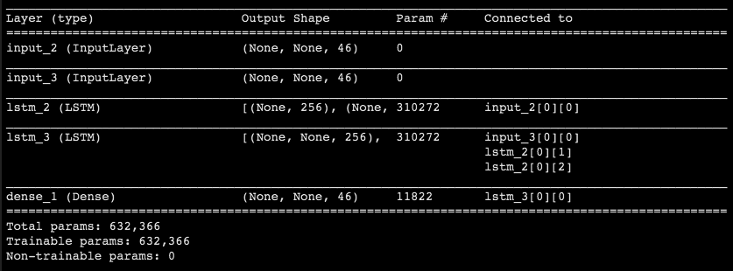
Feed forward NN as gate in LSTM
Number of parameters = 4 * output dimension * (input_dimension + output dimension + bias) = 4 * 256 * (46 + 256 +1) = 310272
Dense layer number of parameters = 46 * 256 + 46 = 11822
Notes:
There are 256 number of units (neurons). Each neuron also receives H(t-1) and X(t) from input dim. H(t-1) and X(t) are concatenated horizontally to share one W.

Slide 65
Examples of Sequence
Speech
Sentiment classification
Translation
Chat bot
Video
DNA sequence
Customer journey and touchpoint

Slide 66
Feed forward NN as gate in LSTM
Input layer node number = feature count.
Hidden layer node number = hyperparameter
Activation layer = dense layer outputs
…
…
…
Input dim 46
Hidden nodes
256
Activation Dense 46
Argmax wrt vocab
LSTM number of parameters = 4 * LSTM_hidden_layer_nodes (input_layer_node+ hidden_layer_output + bias) = 4 * 256 * (46 + 256 +1) = 310272
Dense layer number of parameters = 46 * 256 + 46 = 11822
Notes:
There are 256 number of units (neurons). Each neuron also receives H(t-1) and X(t) from input dim. H(t-1) and X(t) are concatenated horizontally to share one W.

Slide 67
Feed forward NN as LSTM gates
Previous Hidden state
256
…
Each hidden node neuron receives input X and previous state h.
…
…
Input dim 46
Hidden nodes
256
…
Activation Dense 46
LSTM number of parameters = 4 * LSTM_hidden_layer_nodes (input_layer_node+ hidden_layer_output + bias) = 4 * 256 * (46 + 256 +1) = 310272
Dense layer number of parameters = 46 * 256 + 46 = 11822

Slide 69
How does it know it’s time for me to work?
How does it know where I work?
How does it know I am heading to work?

Slide 71
Feed forward NN as gate in LSTM
Input layer node number = feature count.
Hidden layer node number = hyperparameter
Activation layer = dense layer outputs
…
…
…
Input dim 46
Hidden nodes
256
Activation Dense 46
Argmax wrt vocab
Number of parameters = 4 * hidden_layer_nodes * (input_layer_node+ hidden_layer_output + bias) = 4 * 256 * (46 + 256 +1) = 310272
Dense layer number of parameters = 46 * 256 + 46 = 11822
Notes:
There are 256 number of units (neurons). Each neuron also receives H(t-1) and X(t) from input dim. H(t-1) and X(t) are concatenated horizontally to share one W.

